Slide 1
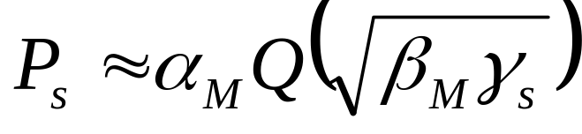
Modulation and Detection
Linear modulation more spectrally efficient but less robust than nonlinear modulation
P_{s} approximation in AWGN:
  Alternate Q function representation simplifies calculations
In fading P_{s} is a random variable, characterized by average value, outage, or combined outage/average
Outage probability based on target SNR in AWGN.
Fading greatly increases average P_{s .}

Slide 2
Passband Modulation Tradeoffs
Want high rates, high spectral efficiency, high power efficiency, robust to channel, cheap.
Amplitude/Phase Modulation (MPSK,MQAM)
  Information encoded in amplitude/phase
  More spectrally efficient than frequency modulation
  Issues: differential encoding, pulse shaping, bit mapping.
Frequency Modulation (FSK)
  Information encoded in frequency
  Continuous phase (CPFSK) special case of FM
  Bandwidth determined by Carson’s rule
  More robust to channel and amplifier nonlinearities
Our focus

Slide 3
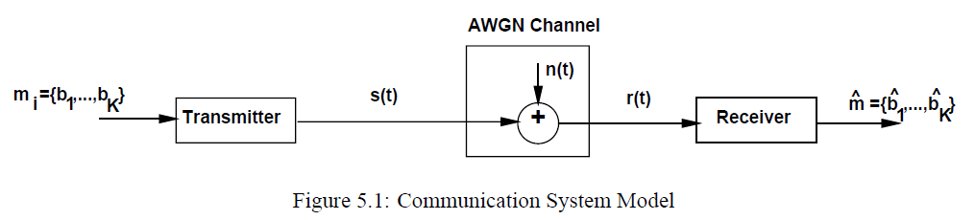
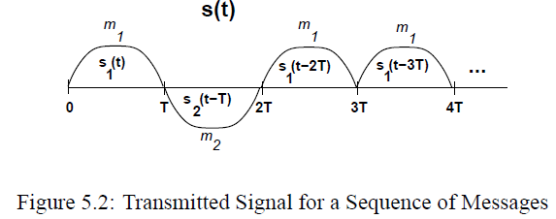

Signal and System Model
Design to minimize

Slide 4






Geomtric Representation
Basis function representation
For bandpass modulation
Pulse-shaping

Slide 5
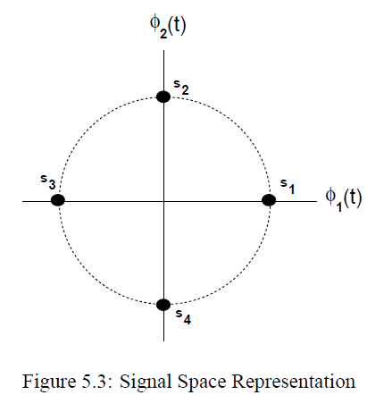




Signal Space

Slide 6
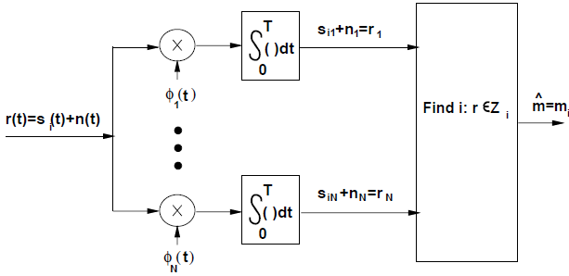



Receiver Structure and Sufficient Statistics
Sufficient Statistics

Slide 7
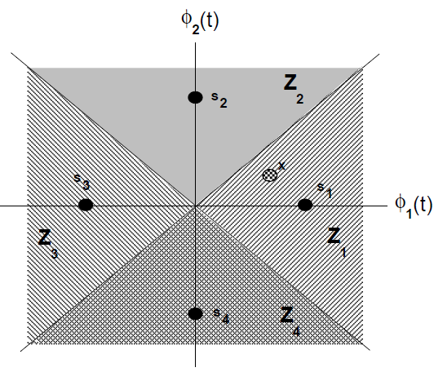





Decision Region and Max. Likelihood Criterion
Bayes rule
Equi-probable
Log-likelihood under AWGN

Slide 8
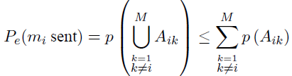
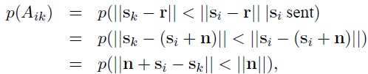








Error Prob. and Union Bound
Nearest neighbor approx.

Slide 9

Passband Modulation Principles
Amplitude, Frequency, Phase modulation
In-phase
Quadrature
Complex low-pass representation

Slide 10
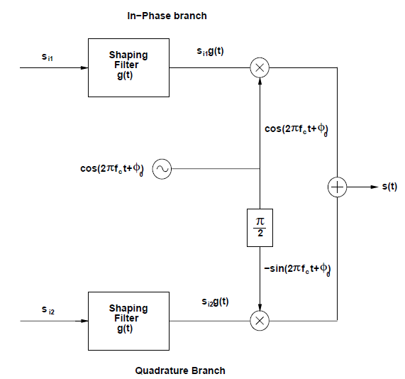
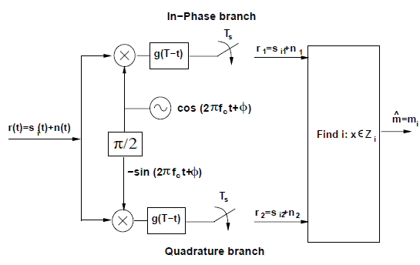
Amplitude and Phase Modulation
Pulse amplitude modulation (MPAM)
Phase-shift keying (MPSK)
Quadrature amplitude modulation (MQAM)

Slide 11


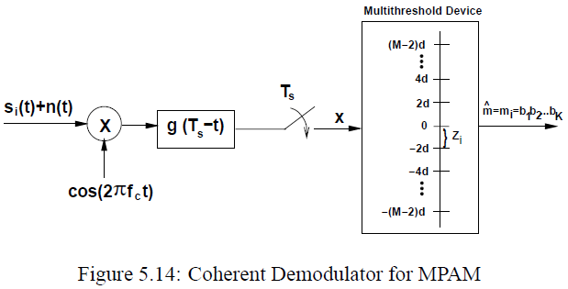
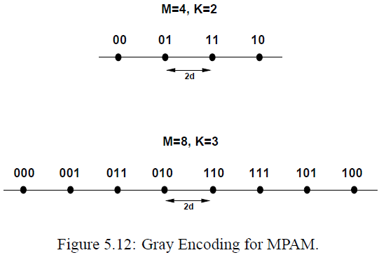
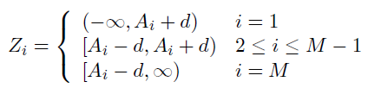
Pulse Amplitude Modulation

Slide 12
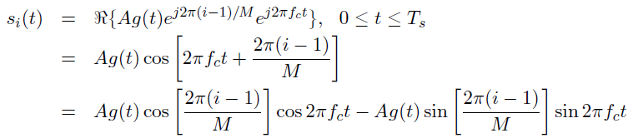

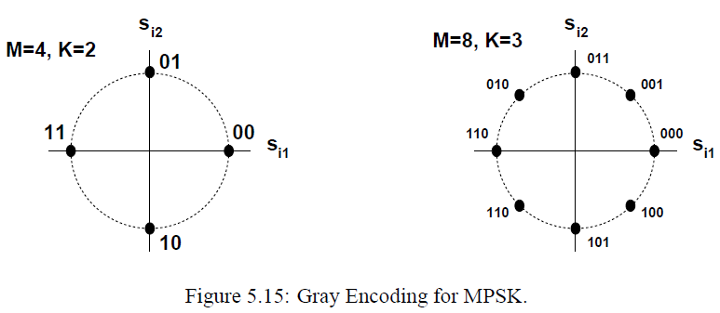
Phase-Shift Keying

Slide 13
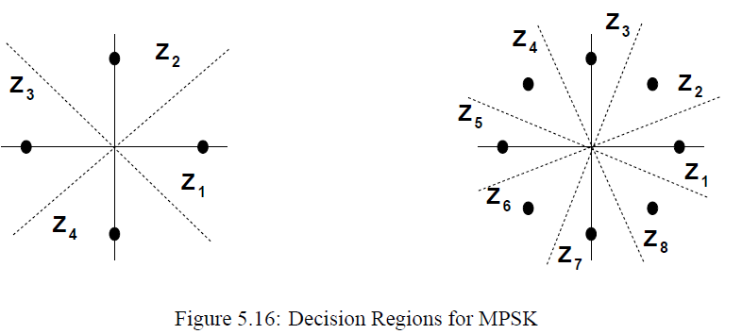
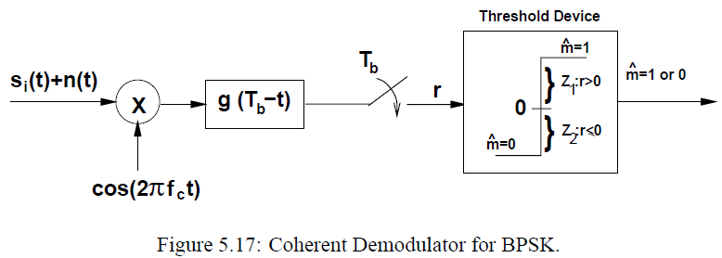
Phase-Shift Keying (2)

Slide 14

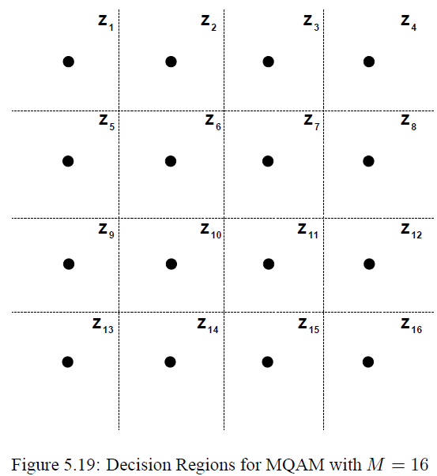
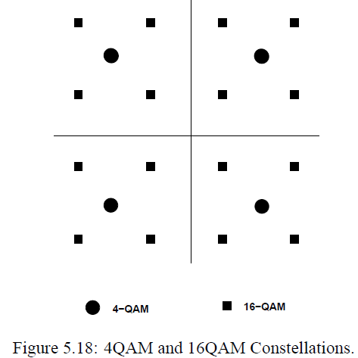
Quadrature Amplitude Modulation

Slide 15
Differential Phase-Shift Keying
Noncoherent det. impossible for traditional PSK
DPSK eliminates the need for reference
Differential encoding of the input
Phase-shift keying

Slide 16
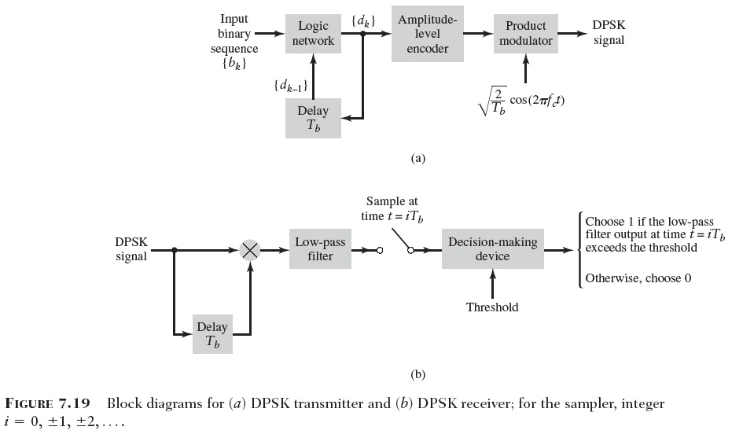
Generation & Detection of DPSK

Slide 17
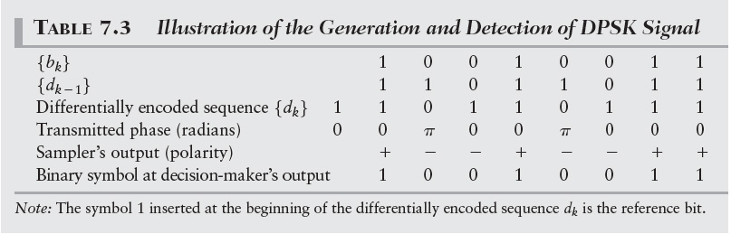
Binary Data Stream

Slide 18
Performance of Digital Modulation
Performance metric
  Probability of errors
  Outage probability
Performance over different channels
  AWGN
  Flat fading
  Frequency-selective
  Doppler shift (time-varying)
Impact on performance of noise and fading

Slide 19




AWGN Channels
Signal-to-noise ratio (SNR)
With for raised-cosine pulse,
SNR per symbol
SNR per bit
For M-ary signaling (MPSK, MPAM)

Slide 20


Error Prob. for BPSK
BPSK signal

Slide 21






Error Prob. for QPSK
QPSK = 2 BPSK at two branches
Bit error rate
Symbol error rate
Union Bound
Nearest neighbor approx.

Slide 22




Error Prob. for MPSK
MPSK signal
Joint distribution
Marginal distribution
Probability of error

Slide 23



Error Prob. for MPAM
MPAM signal
Inner constellation
Outer constellation
Probability of error
Average energy per symbol

Slide 24




Error Prob. for MQAM
MQAM with square constellation
Can be viewed as two MPAM with size L
With M replaced by , error prob. per branch
The symbol error prob. for MQAM
Nearest neighbor approx.

Slide 25
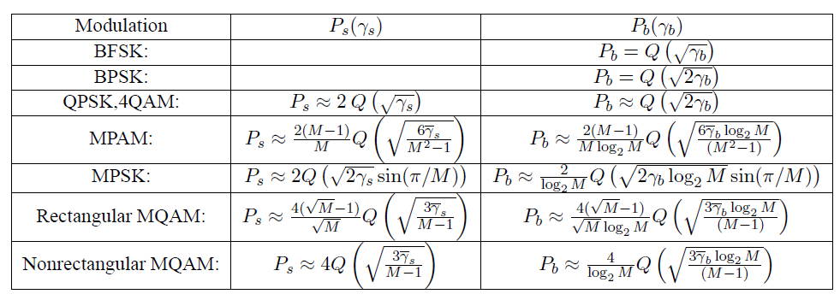
Error Prob. for Different Modulation

Slide 26
Main Points
Linear modulation more spectrally efficient but less robust than nonlinear modulation
P_{s} approximation in AWGN:
  Alternate Q function representation simplifies calculations

Slide 27

Fading Channels
Outage probability
  Probability that P_{s} is above target
  Equivalently, probability γ_{s} below target
  Used when T_{c}>>T_{s}
Average P_{s} in fast fading:
  Averaged over fast fading distribution
  Good metric when T_{c}~T_{s}
  Alternate Q function approach greatly simplifies calculations (switch integral order, becomes Laplace Xfm)
Fading severely degrades performance

Slide 28
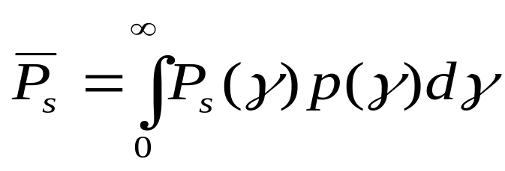
Linear Modulation in Fading
In fading γ_{s} and therefore P_{s} random
Performance metrics:
  Outage probability: p(P_{s}>P_{target})=p(γ<γ_{target})
  Average P_{s} , P_{s}:
  Combined outage and average P_{s}

Slide 29



Outage Probability
The outage probability
For Rayleigh fading
Required average SNR for a given outage probability

Slide 30
Outage Probability
T_{s}
P_{s}
Outage
P_{s(target)}
t or d
Probability that P_{s} is above target
Equivalently, probability γ_{s} below target
Used when T_{c}>>T_{s}

Slide 31








Average Prob. of Error
Average error prob.
Change of variable
For Rayleigh fading
For binary data
For general approx.

Slide 32
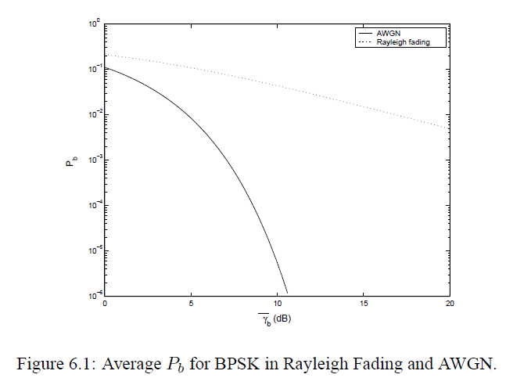
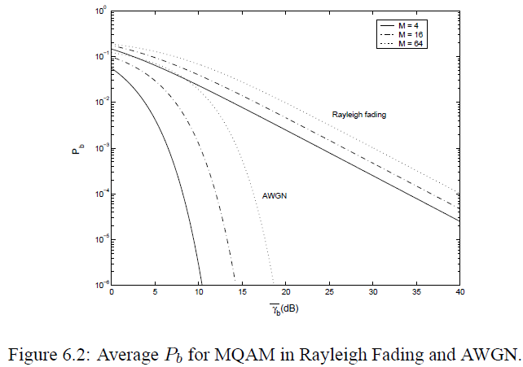
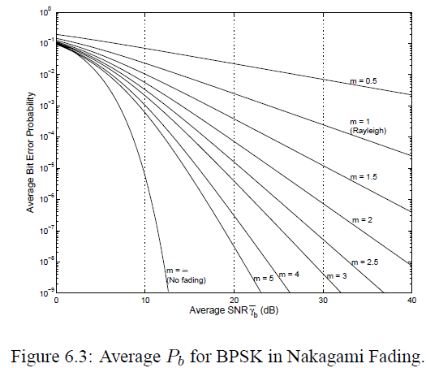
Average Error Performance

Slide 33
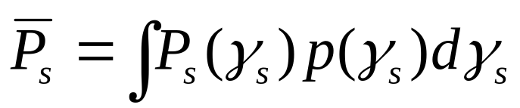
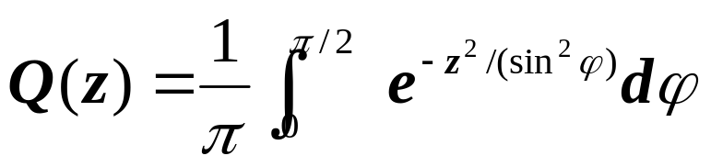
Average P_{s}
T_{s}
P_{s}
P_{s}
t or d
Expected value of random variable P_{s}
Used when T_{c}~T_{s}
Error probability much higher than in AWGN alone
Alternate Q function approach:
  Simplifies calculations (Get a Laplace Xfm)

Slide 34
Combined outage and average P_{s}
P_{s}(γ_{s})
Outage
P_{s}(γ_{s})
P_{starget}
P_{s}(γ_{s})
Used in combined shadowing and flat-fading
P_{s} varies slowly, locally determined by flat fading
Declare outage when P_{s} above target value

Slide 35
Doppler Effects
High doppler causes channel phase to decorrelate between symbols
Leads to an irreducible error floor for differential modulation
  Increasing power does not reduce error
Error floor depends on B_{d}T_{s}

Slide 36
ISI Effects
Delay spread exceeding a symbol time causes ISI (self interference).
ISI leads to irreducible error floor
  Increasing signal power increases ISI power
ISI requires that T_{s}>>T_{m} (R_{s}<<B_{c})
1
2
3
4
5
0
T_{s}
T_{m}

Slide 37
Main Points
In fading P_{s} is a random variable, characterized by average value, outage, or combined outage/average
  Outage probability based on target SNR in AWGN.
  Fading greatly increases average P_{s .}
  Alternate Q function approach simplifies P_{s} calculation, especially its average value in fading (Laplace Xfm).
Doppler spread only impacts differential modulation causing an irreducible error floor at low data rates
Delay spread causes irreducible error floor or imposes rate limits
Need to combat flat and frequency-selective fading
  Focus of the remainder of the course

